Slide 1
Clustering with Deep Learning: Taxonomy and New Methods
Technical University of Munich
Computer Vision Group
(ICLR 2018 under review)

Slide 2
Introduction
Clustering:
a fundamental unsupervised machine learning problem
Main Goal:
to separate data (vectors) into clusters of similar data points
Applications:
automatic data labeling
Data visualization and analysis
……

Slide 3
Traditional Methods (K-means)
Iteratively:
Assignment step:
Assign each observation to the cluster whose mean has the least distance
Update step:
Calculate the new means to be the centroids of the observations in the new clusters.

Slide 4
Traditional Methods (Hierarchical clustering)
Agglomerative (bottom up):
each observation starts in its own cluster, and pairs of clusters are merged as one moves up the hierarchy.
Divisive (top down):
all observations start in one cluster, and splits are performed recursively as one moves down the hierarchy.

Slide 5
Clustering with Deep Learning
Naive method:
Obtain vector representation (embedding) by deep learning
Apply classical clustering methods
Problem:
The embedding vectors are not friendly to clustering algorithms (e.g. K-means)
Mapping data into clustering-friendly representations

Slide 6
Architecture
Representation
Encoder
Decoder
Original
data
Non-clustering Loss
Clustering
Loss
End-to-End Clustering
or
K-means Clustering

Slide 7
Two ways of clustering
Jointly update (end-to-end):
Clustering assignments are formulated as probabilities
Alternatingly update (like k-means):
Clustering assignments are discrete
Iteratively:
Strict clustering assignments, update neural network
Update clustering assignments

Slide 8
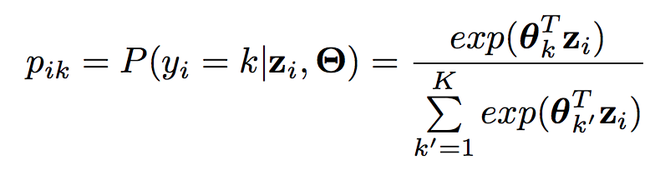
Jointly Update (DEPICT: Dizaji et al., 2017)
No explicit cluster center
Representation
Fully Connected Layer
Softmax
Probabilities
Loss

Slide 9
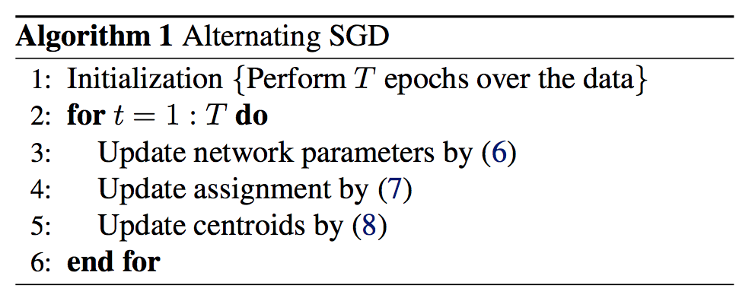

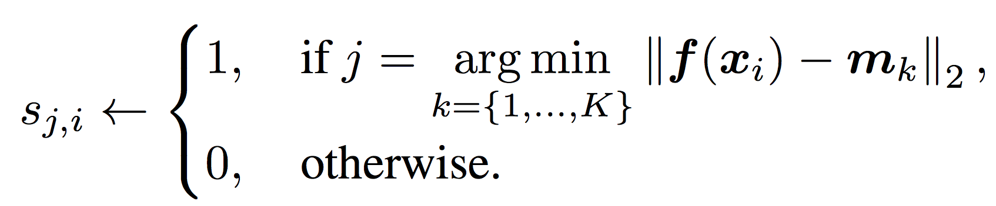
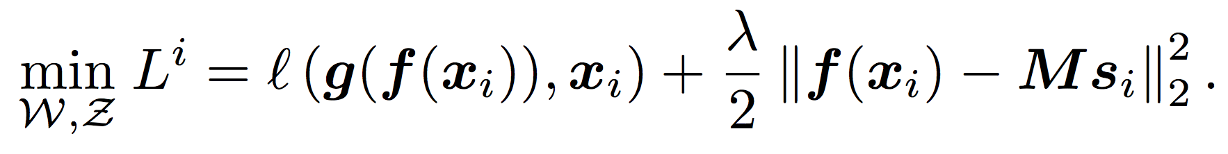
Alternatively Update (DCN: Yang et al., 2016)
encoder
cluster assignments
decoder
centroids

Slide 10
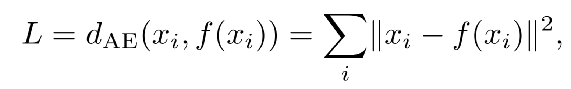
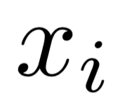
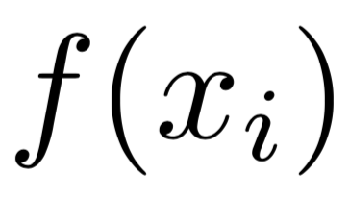
Non-clustering Loss
Typical: Auto-encoder reconstruction loss
Experimental Result:
no non-clustering loss can have a danger of worse representations/results.
is the input
Is the auto-encoder reconstruction

Slide 11
Clustering Loss
To generate clustering-friendly representations
K-means friendly loss:
Data points are evenly distributed around the cluster centers
Locality-preserving loss:
To push nearby data points together
Group sparsity loss:
To generate representations, each of which related to only a few clusters

Slide 12
Clustering Loss
Soft (probability) assignment only
Cluster assignment hardening:
Forces assignments to have stricter probabilities (closer to 0 and 1)
Balanced assignment loss:
To enforce having balanced cluster assignments

Slide 13
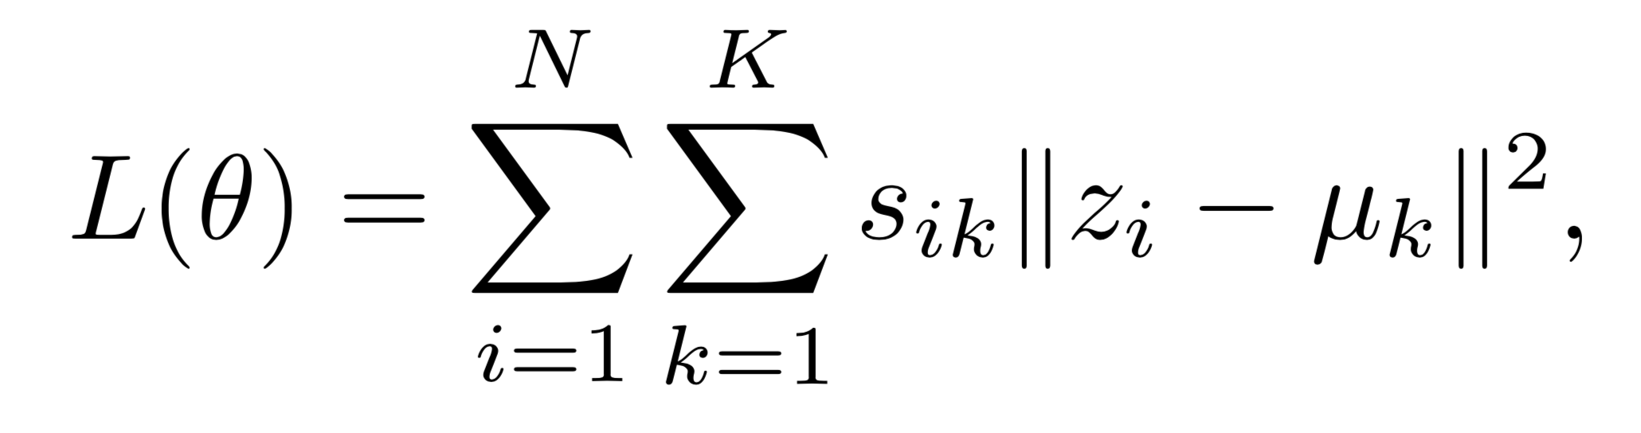
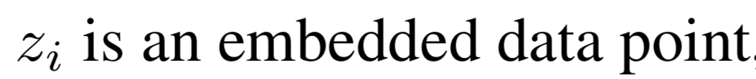
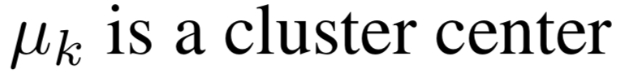
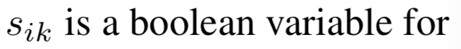
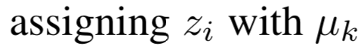
K-means friendly loss
Data points are evenly distributed around the cluster centers

Slide 14
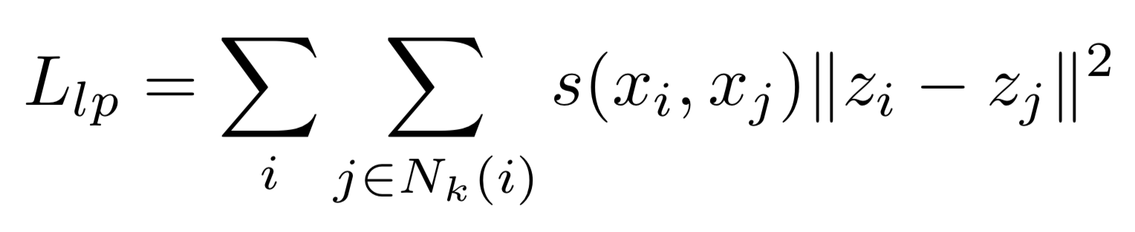
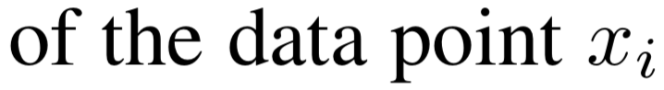
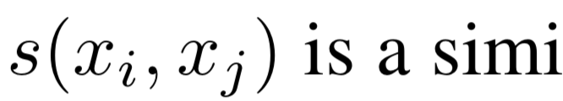
Locality-preserving loss
To push nearby data points together

Slide 15
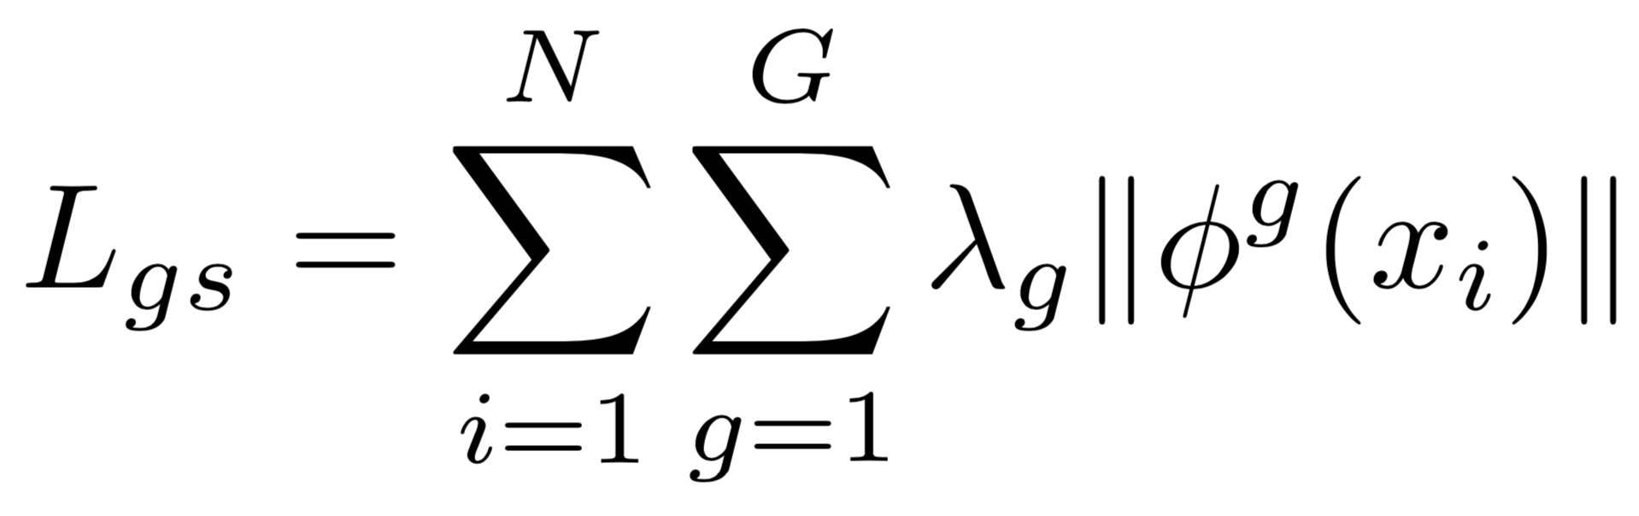
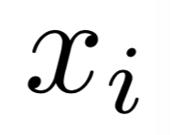
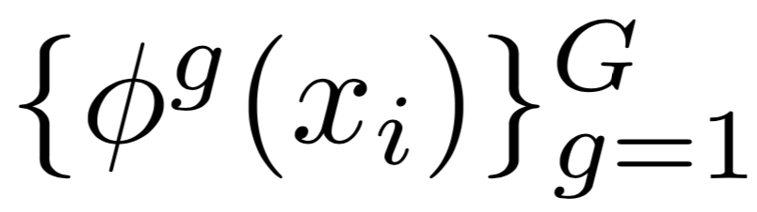
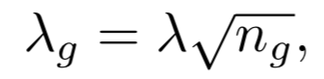
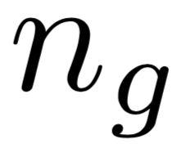
Group sparsity loss
To generate representations, each of which related to only a few clusters
The hidden units were divided into G groups, where G is the assumed number of clusters.
When given a data point , the obtained representation has the form
where is the group size and λ is a constant

Slide 16
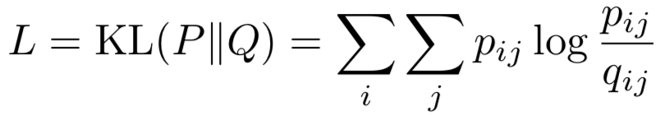
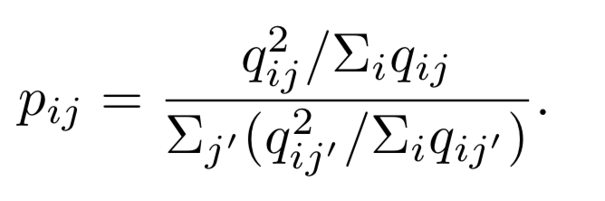
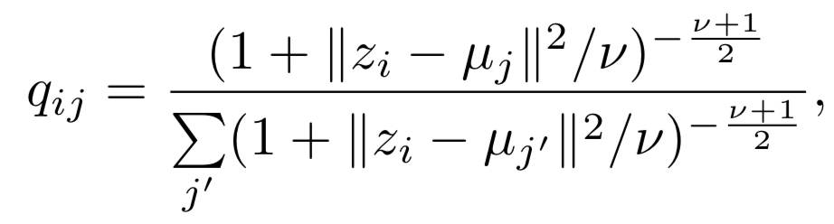
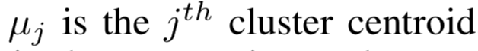
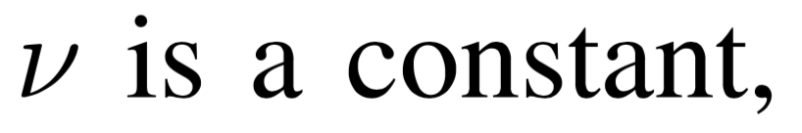
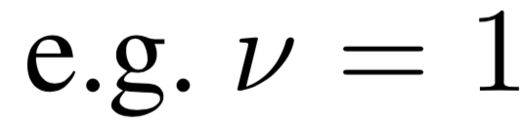
Cluster assignment hardening
Forces assignments to have stricter probabilities (closer to 0 and 1)

Slide 17
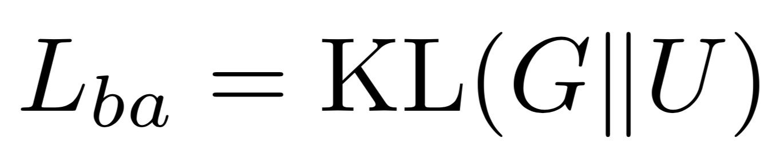
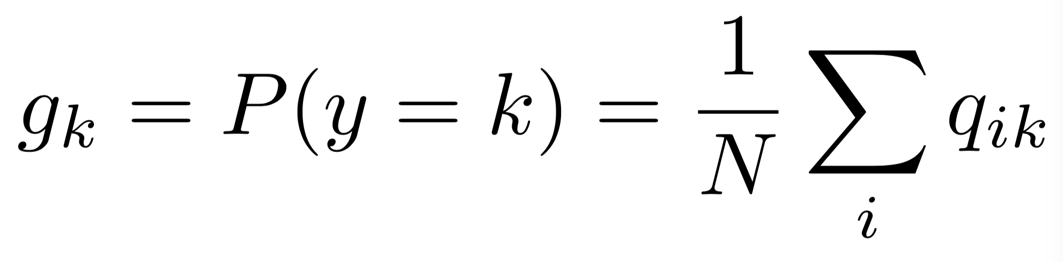
Balanced assignment loss
To enforce having balanced cluster assignments

Slide 18
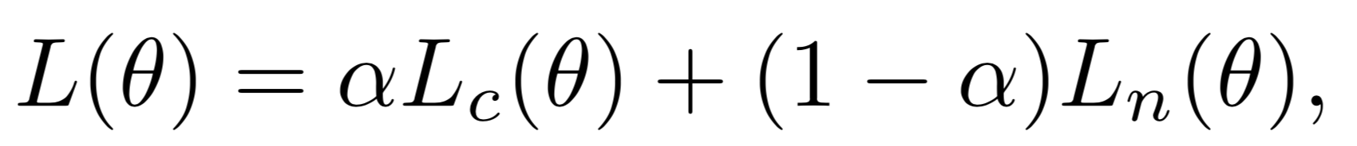
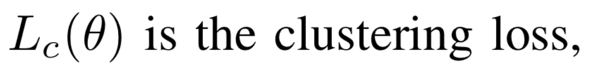
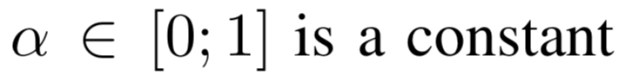
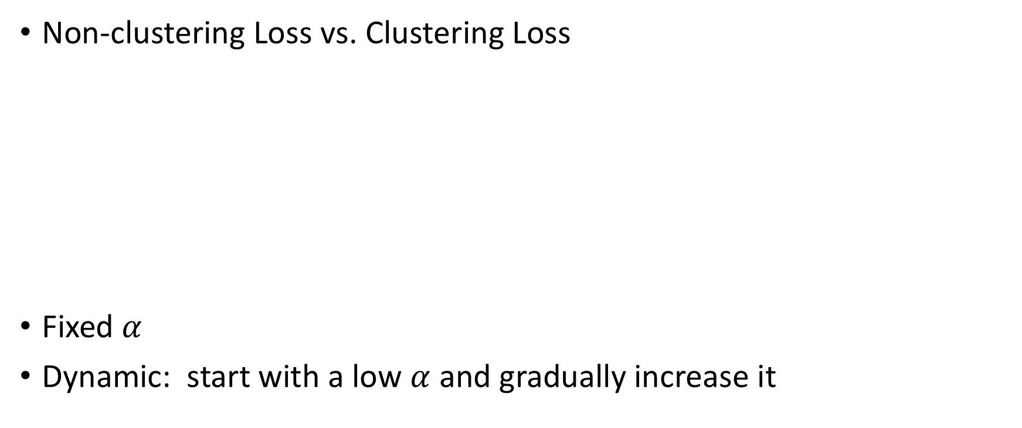
Loss combination
Non-clustering Loss vs. Clustering Loss
Fixed $α$
Dynamic: start with a low $α$ and gradually increase it

Slide 19
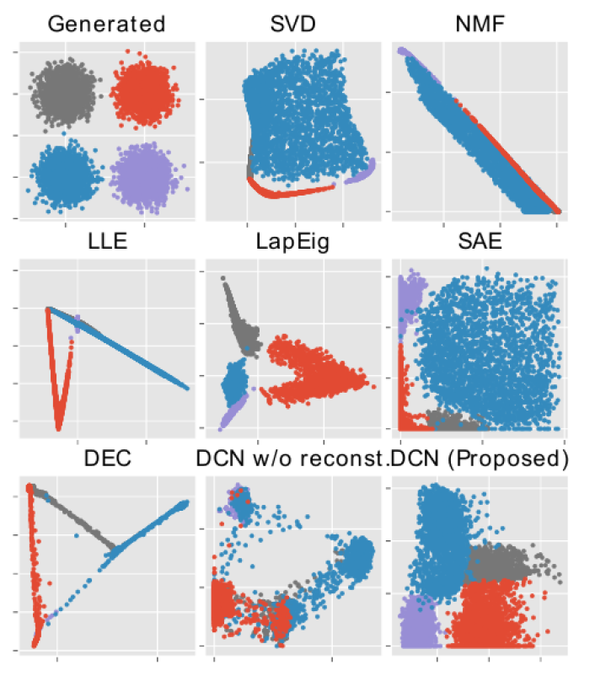
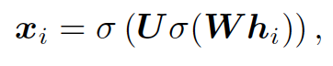
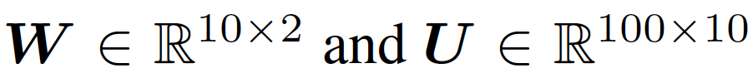
Experiments (DCN: Yang et al., 2016)
Data generation

Slide 20
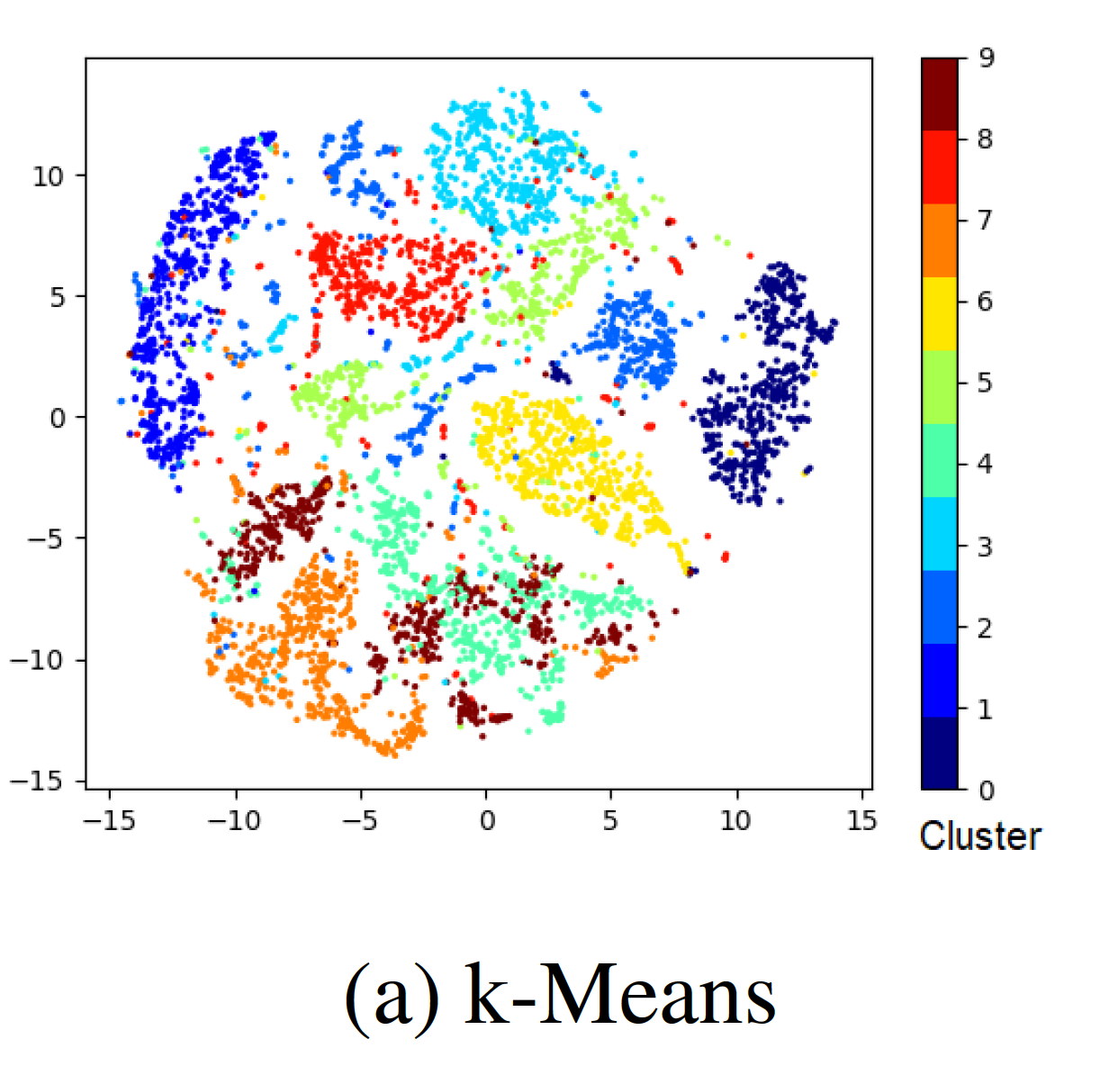
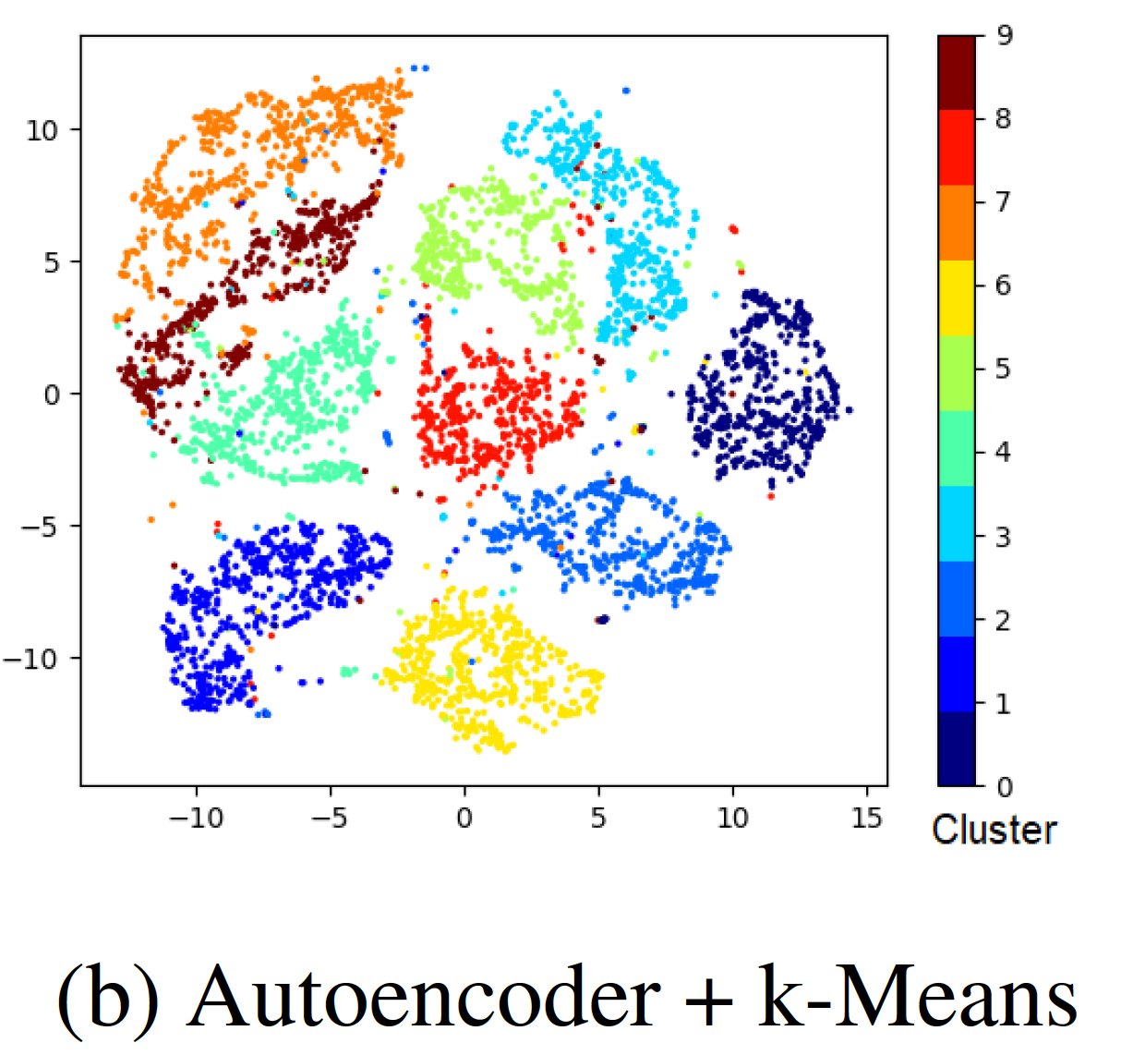
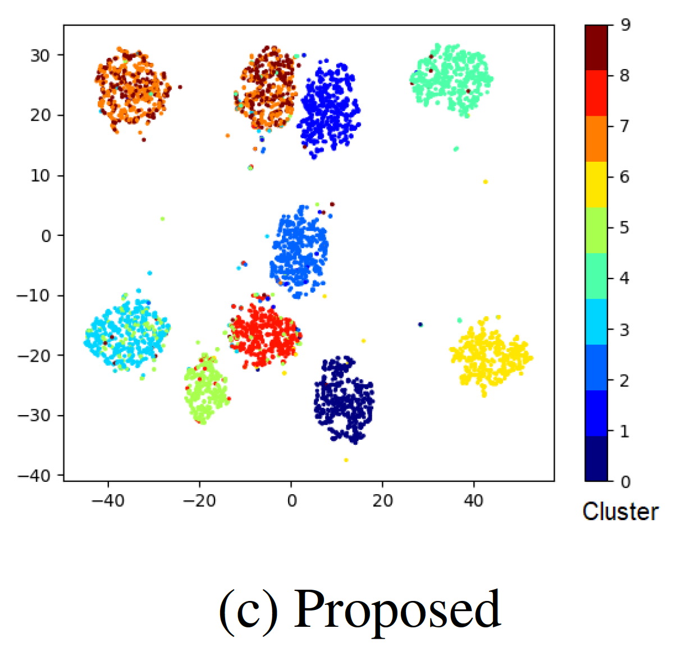
Experiments
MNIST

Slide 21
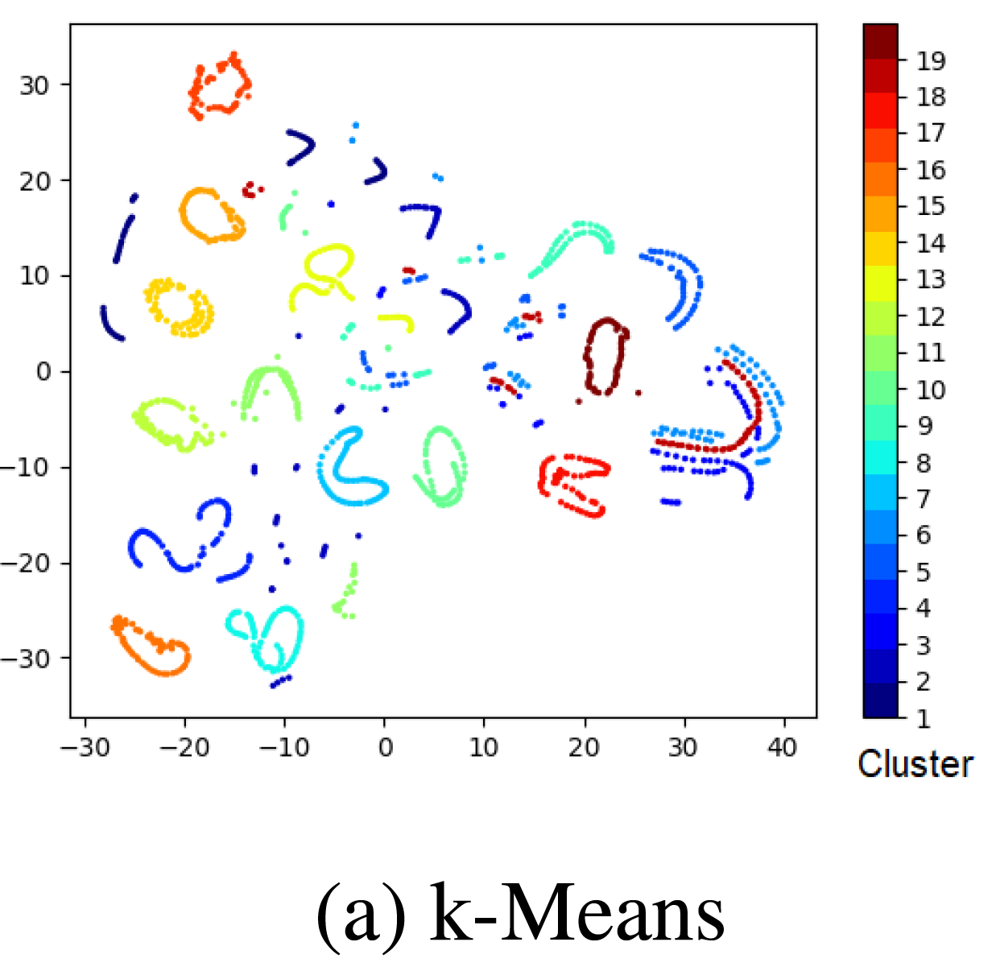
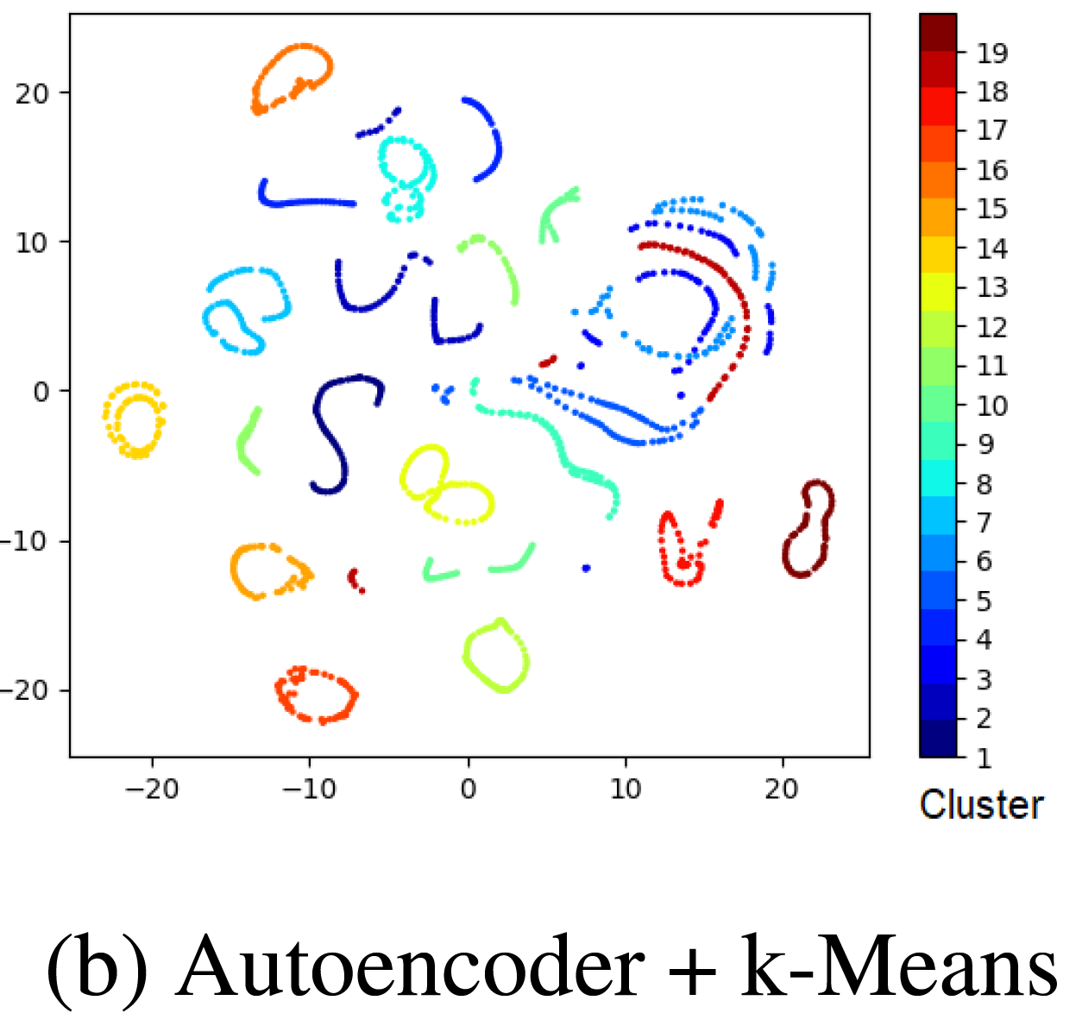
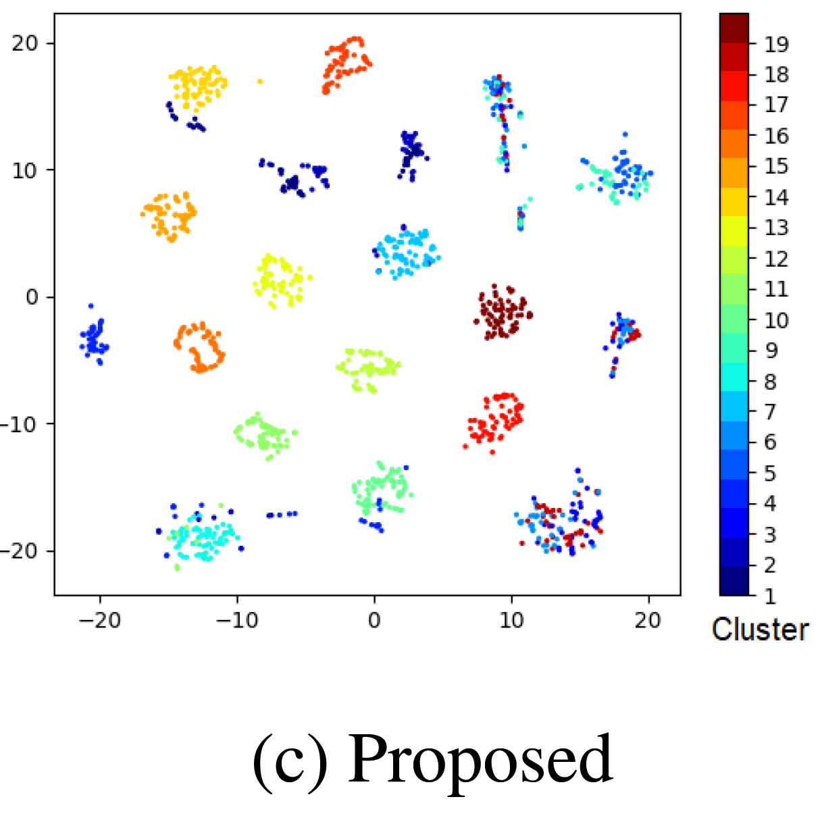
Experiments
COIL20

Slide 22
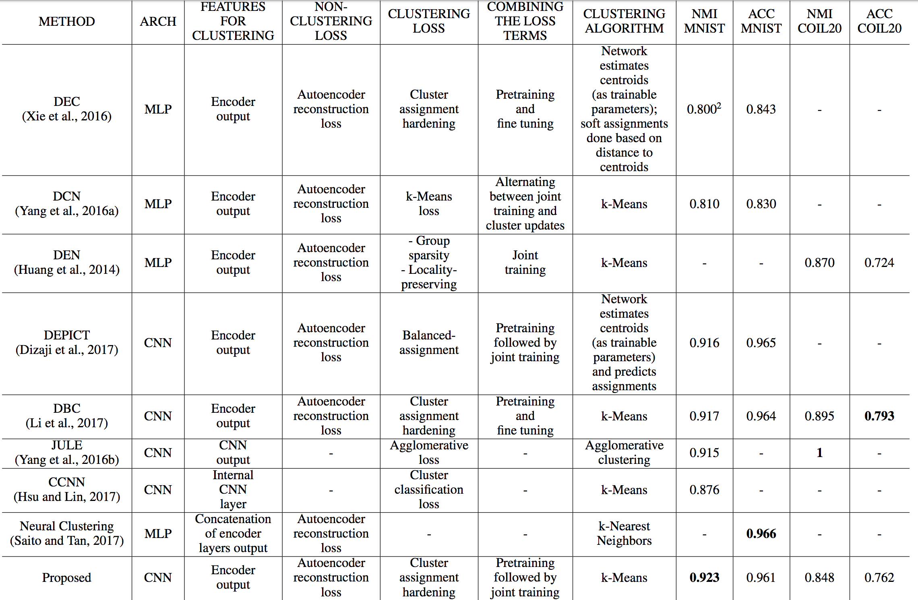

Slide 23
Thanks! Q&A

